Slide 1
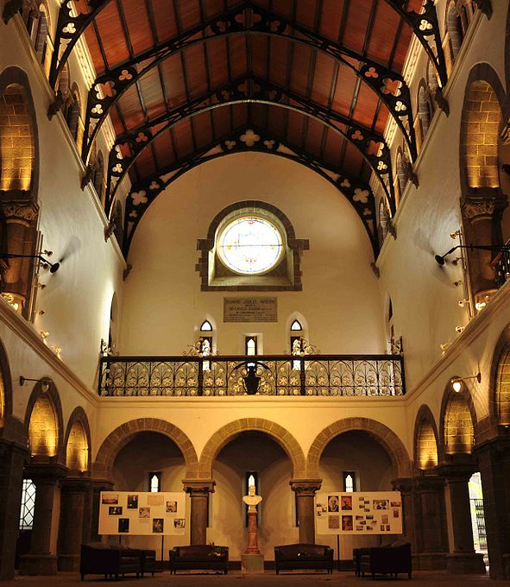

B. TECH. PROJECT END SEM REPORT LeafNST: An Improved Data Augmentation Method for Classification of Plant Disease using Object-Based Neural Style Transfer
Project Guide:
Dr. Sunil Mane
Team Members:
Ninad Barve - 112003016
Om Khare - 112003066
Harshmohan Kulkarni - 112003075
COEP Technological University (COEP Tech) , Pune (A Unitary Public University of Govt. Of Maharashtra)
1

Slide 2
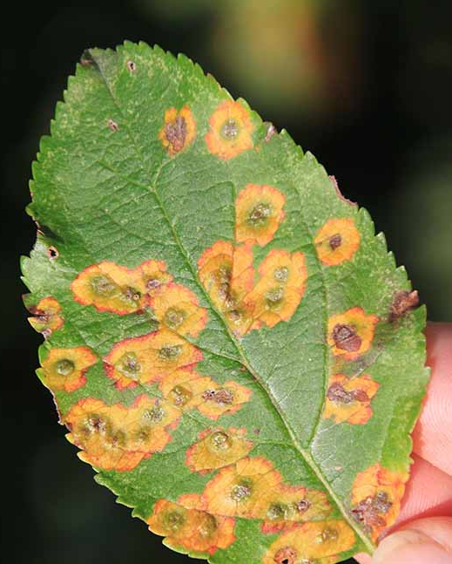
Agenda
Introduction
Literature Review
Research Gaps
Proposed Methodology
Result
Conclusion
COEP Technological University (COEP Tech) , Pune (A Unitary Public University of Govt. Of Maharashtra)

Slide 3
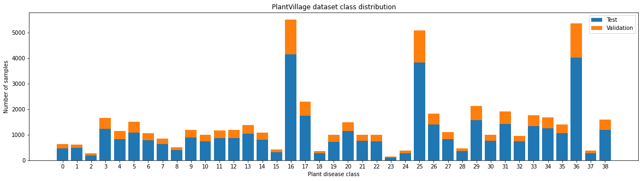
Introduction
Motivation
Plant diseases significantly threaten global agriculture, impacting crop yield and food security and nearly 30% of the crop yield is lost due to plant diseases.
Efficient identification and classification of plant diseases through computer vision techniques have become imperative for timely intervention.
However, popular plant disease datasets often suffer from data imbalance, with certain classes underrepresented, hindering the performance of machine learning models.
COEP Technological University (COEP Tech) , Pune (A Unitary Public University of Govt. Of Maharashtra)

Slide 4
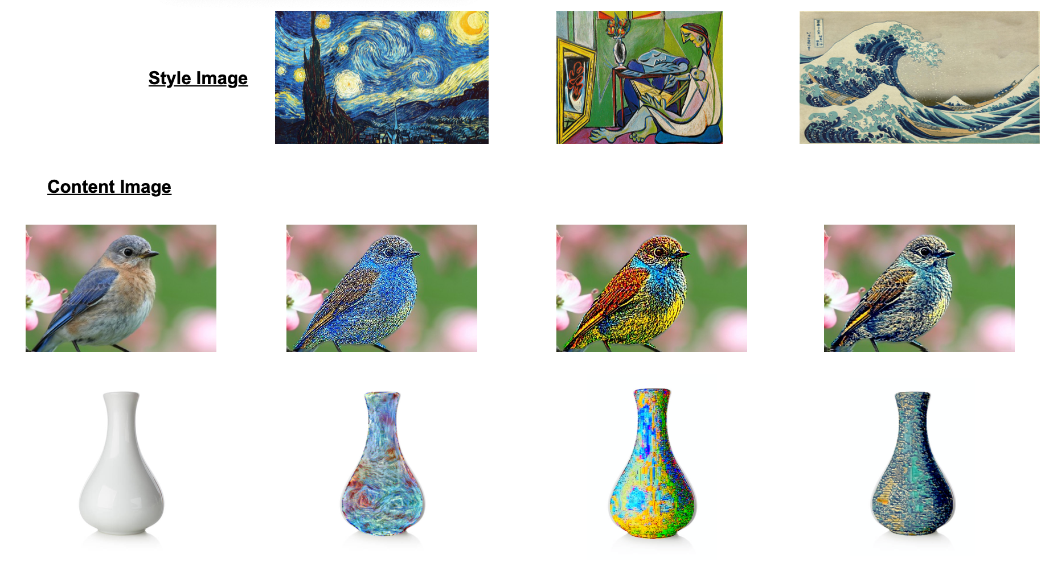
Introduction
Part 1- Developing Object-based Neural Style Transfer
Our initial work which converted into the paper titled ”Improved Object-based Style Transfer with Single Deep Network” introduces a pioneering methodology for object-based image-to-image style transfer.
This innovative approach employs a single deep convolutional neural network that ingeniously integrates the capabilities of You Only Look Once version 8 (YOLOv8) for object segmentation with a CNN for style transfer.
COEP Technological University (COEP Tech) , Pune (A Unitary Public University of Govt. Of Maharashtra)

Slide 5
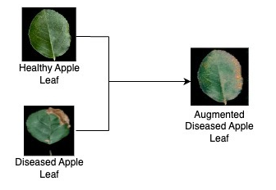
Introduction
Part 2- Using the above approach for Data Augmentation and comparing it with other SOTA Data Augmentation methods
Building upon our previous research, we have addressed the aforementioned data imbalance issue in plant disease datasets.
By adopting an advanced approach of CNN-based Style Transfer for data augmentation, we were able to generate synthetic images that more accurately represent underrepresented classes within these datasets.
Finally, we have compared our approach of using Neural Style Transfer with other state-of-the-art Data Augmentation methods (including GANs, traditional techniques etc.) on different datasets.
COEP Technological University (COEP Tech) , Pune (A Unitary Public University of Govt. Of Maharashtra)

Slide 6
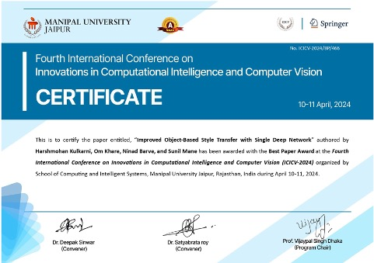
Publication
Part 1 – Paper Accepted and Presented ✓
Paper presented at the Fourth International Conference on Innovations in Computational Intelligence and Computer Vision by Springer
Won Best Paper Award in the entire conference out of 100+ papers presented
The proceedings of ICICV 2024 will soon be published in Lecture Notes in Networks and Systems (LNNS)
Part 2 – Paper Submitted and Under Review ✓
Results of our proposed Data Augmentation Technique are presented in a journal paper
Paper is under review at the Discover Artificial Intelligence by Springer Nature with full fee waiver for open access
COEP Technological University (COEP Tech) , Pune (A Unitary Public University of Govt. Of Maharashtra)

Slide 7
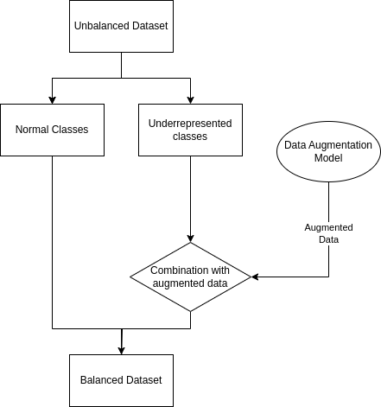
Literature Review
1. Data Augmentation
Traditional Augmentation methods
Flipping, Rotation, Scaling, etc.
Introduce artifacts, alter semantic integrity of data
Novel augmentation techniques automatically select augmentation policies
AutoAugment by Cubuk
Fast AutoAugment by Lim is 33.33 times faster than AA
Population Based Augmentation by Ho
RandAugment by Cubuk
KeepAugment by Gong
Generative Adversarial Networks, GANs are generative models. Able to generate artificial data
Image to Image translation by Isola et. al.
Unpaired Image to Image Translation, CycleGAN by Zhu et. al.
COEP Technological University (COEP Tech) , Pune (A Unitary Public University of Govt. Of Maharashtra)

Slide 8
Literature Review
2. Style Transfer
Origins in texture generation and non-photorealistic rendering
Neural Style Transfer pioneered by Gatys et. Al.
A Neural Algorithm of Artistic Style.
Yongcheng has a great review paper on pre-NST and NST techniques
4. Style Transfer with Object Detection
General style transfer applied on the full image.
Background also gets the style
Some important implementations
VGG-19 + DeepLab-V2 by Virtuosio
VGG + SAM by Psychogyios
3. Object Detection
Image segmentation divides images into groups of pixels
Each pixel group/segment is identified as an object
Fully Convolutional Networks by Long et. al. is an efficient architecture
U-Net by Ronneberger is a derivation of FCNs
Some latest models:
Swin Transfermer
DeepLab
SAM
YOLO
5. Data Augmentation using Style Transfer
Common style in small datasets
Plant diseases can be seen as patterns
6. Comparison with other work
Sofian Zalouk and Sharan Ramjee. Image data augmentation for plant leaf disease classification using neural style transfer.
COEP Technological University (COEP Tech) , Pune (A Unitary Public University of Govt. Of Maharashtra)

Slide 9
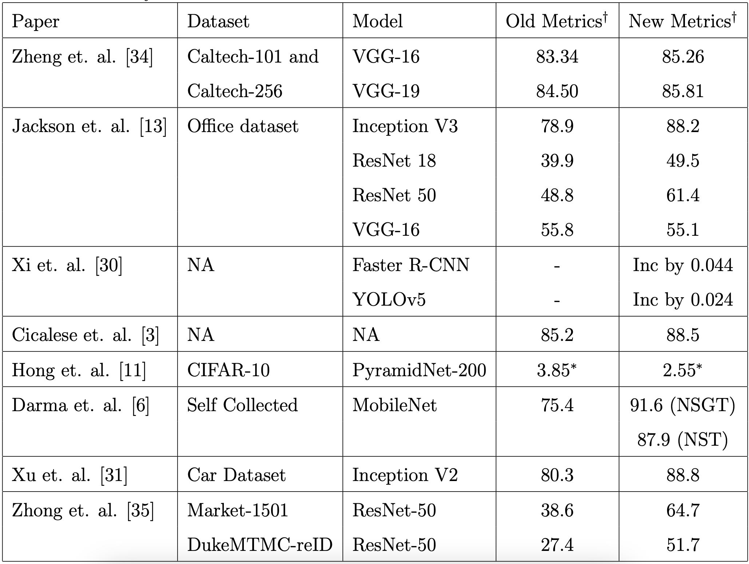
COEP Technological University (COEP Tech) , Pune (A Unitary Public University of Govt. Of Maharashtra)

Slide 10
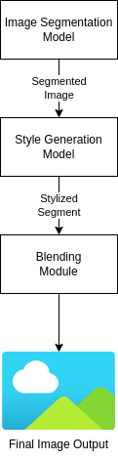
Research Gaps
Single Deep Neural Network
Multiple papers propose a future implementation of a single model for image segmentation and style transfer tasks
Castillo et. al. , Psychogyios et. al. , Virtusio et. Al.
No paper yet published with this implementation
Segmentation models
Newer faster segmentation models have been developed.
Latest SOTA is the YOLOv8 model for segmentation.
Previous researches have used the old SOTA like DeepLab and SAM
Plant Disease Dataset Augmentation
Plant diseases usually look like spots, lines or patches
Such patterns could be used as style
Style transfer has not been well explored yet for the application of plant disease datasets
COEP Technological University (COEP Tech) , Pune (A Unitary Public University of Govt. Of Maharashtra)

Slide 11
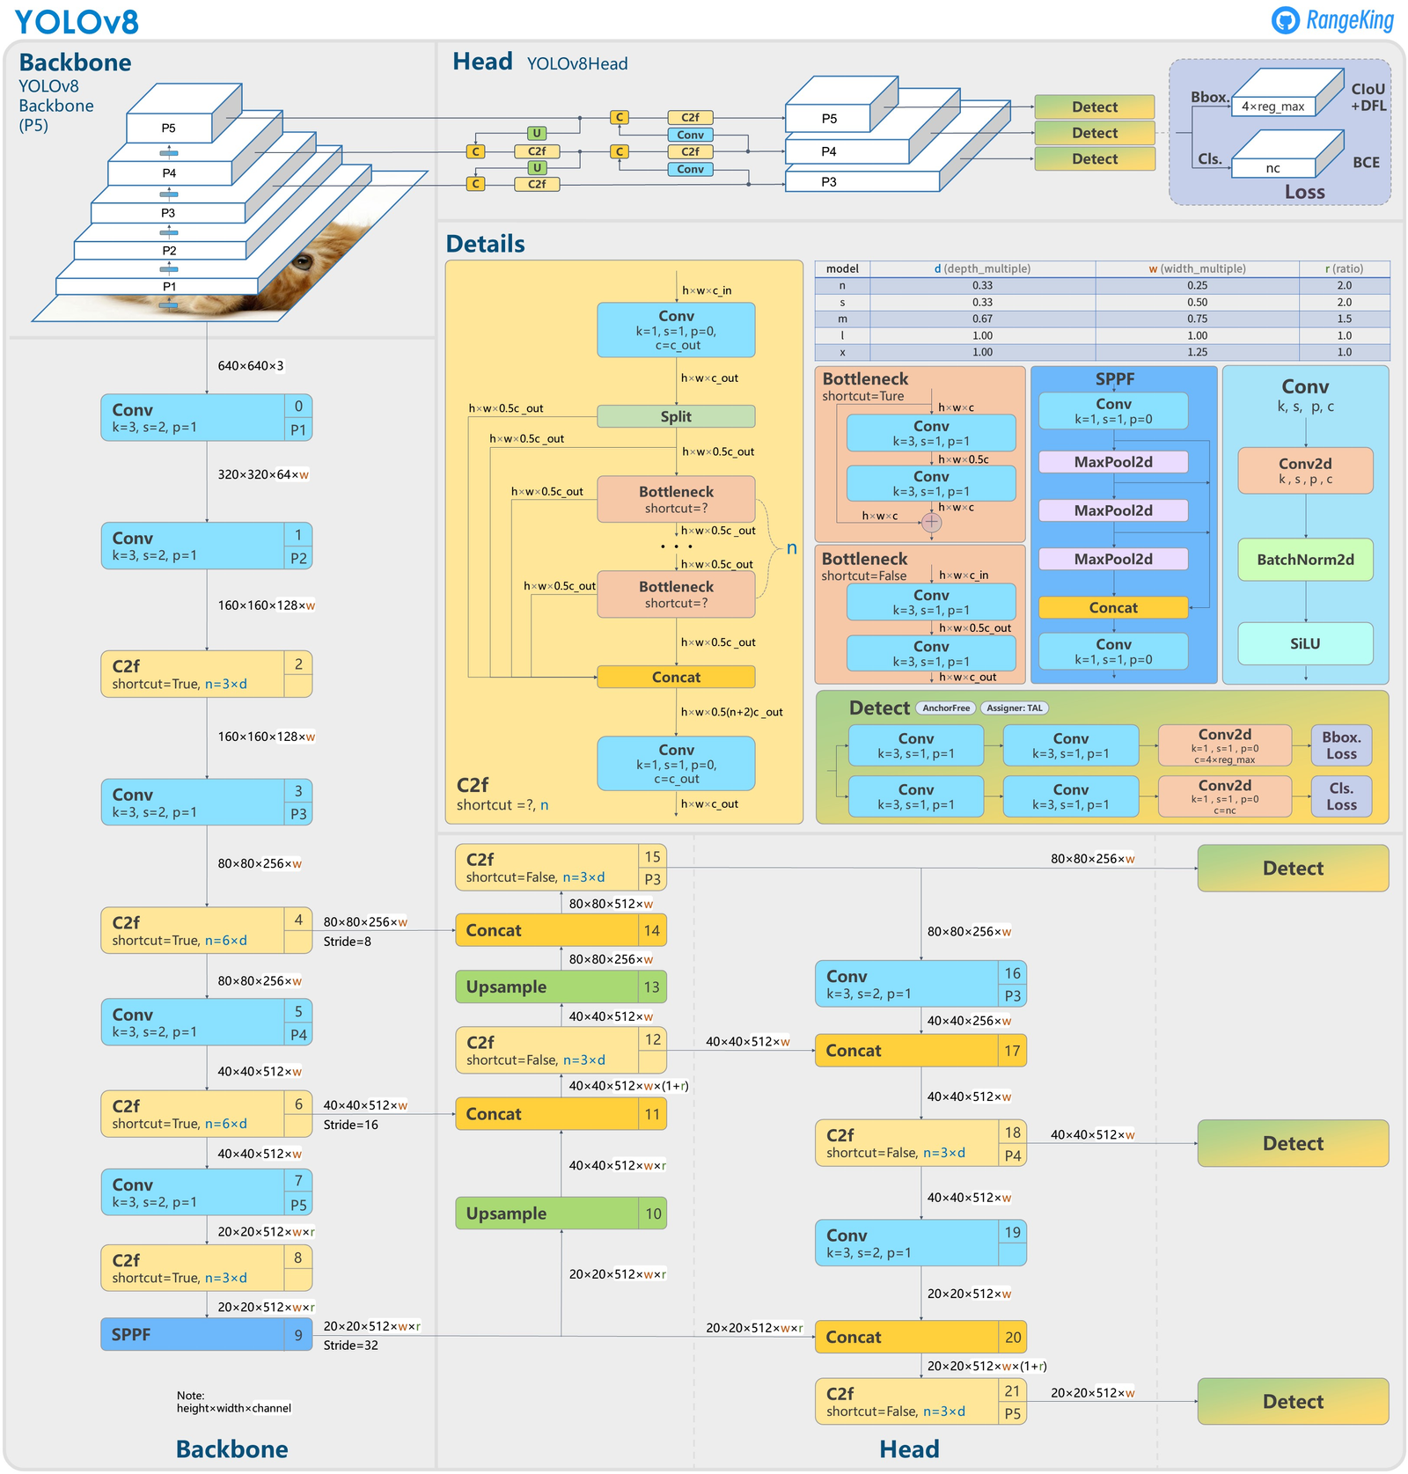
Methodology
Architecture of YOLOv8: YOLOv8’s backbone architecture is inspired by YOLOv5 but includes several key modifications
Backbone: The backbone network is responsible for differentiation of instances, classification of images downstream, and creation of a map of features obtained.
Head: The detection head utilizes the backbone network features predicting object locations and sizes
COEP Technological University (COEP Tech) , Pune (A Unitary Public University of Govt. Of Maharashtra)

Slide 12
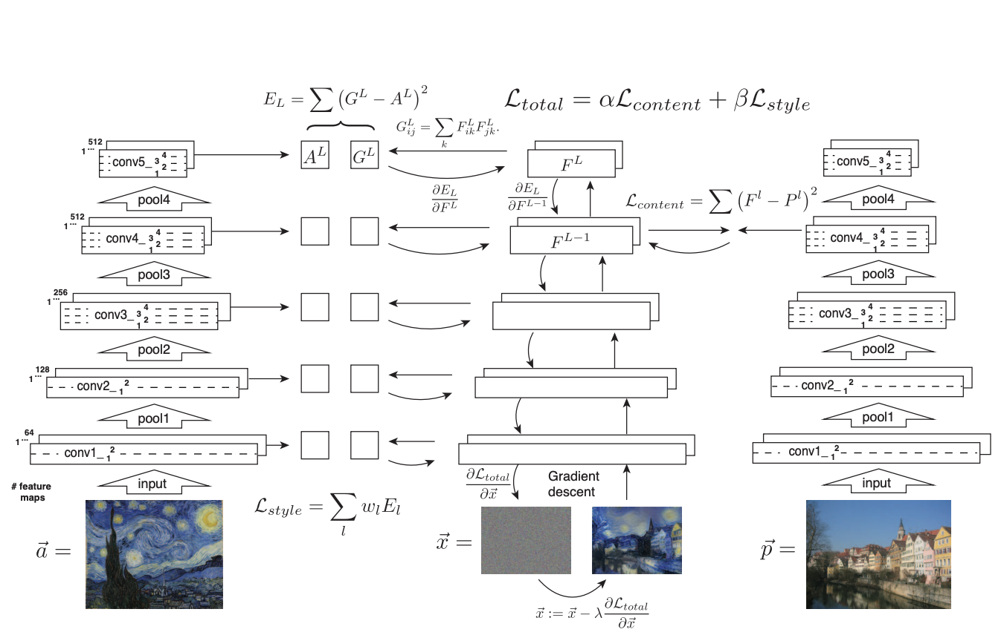
Methodology – Part 1 : Style Transfer
The diagram illustrates the process of Style Transfer, where both a style image and an object image are input into a deep neural network.
COEP Technological University (COEP Tech) , Pune (A Unitary Public University of Govt. Of Maharashtra)

Slide 13
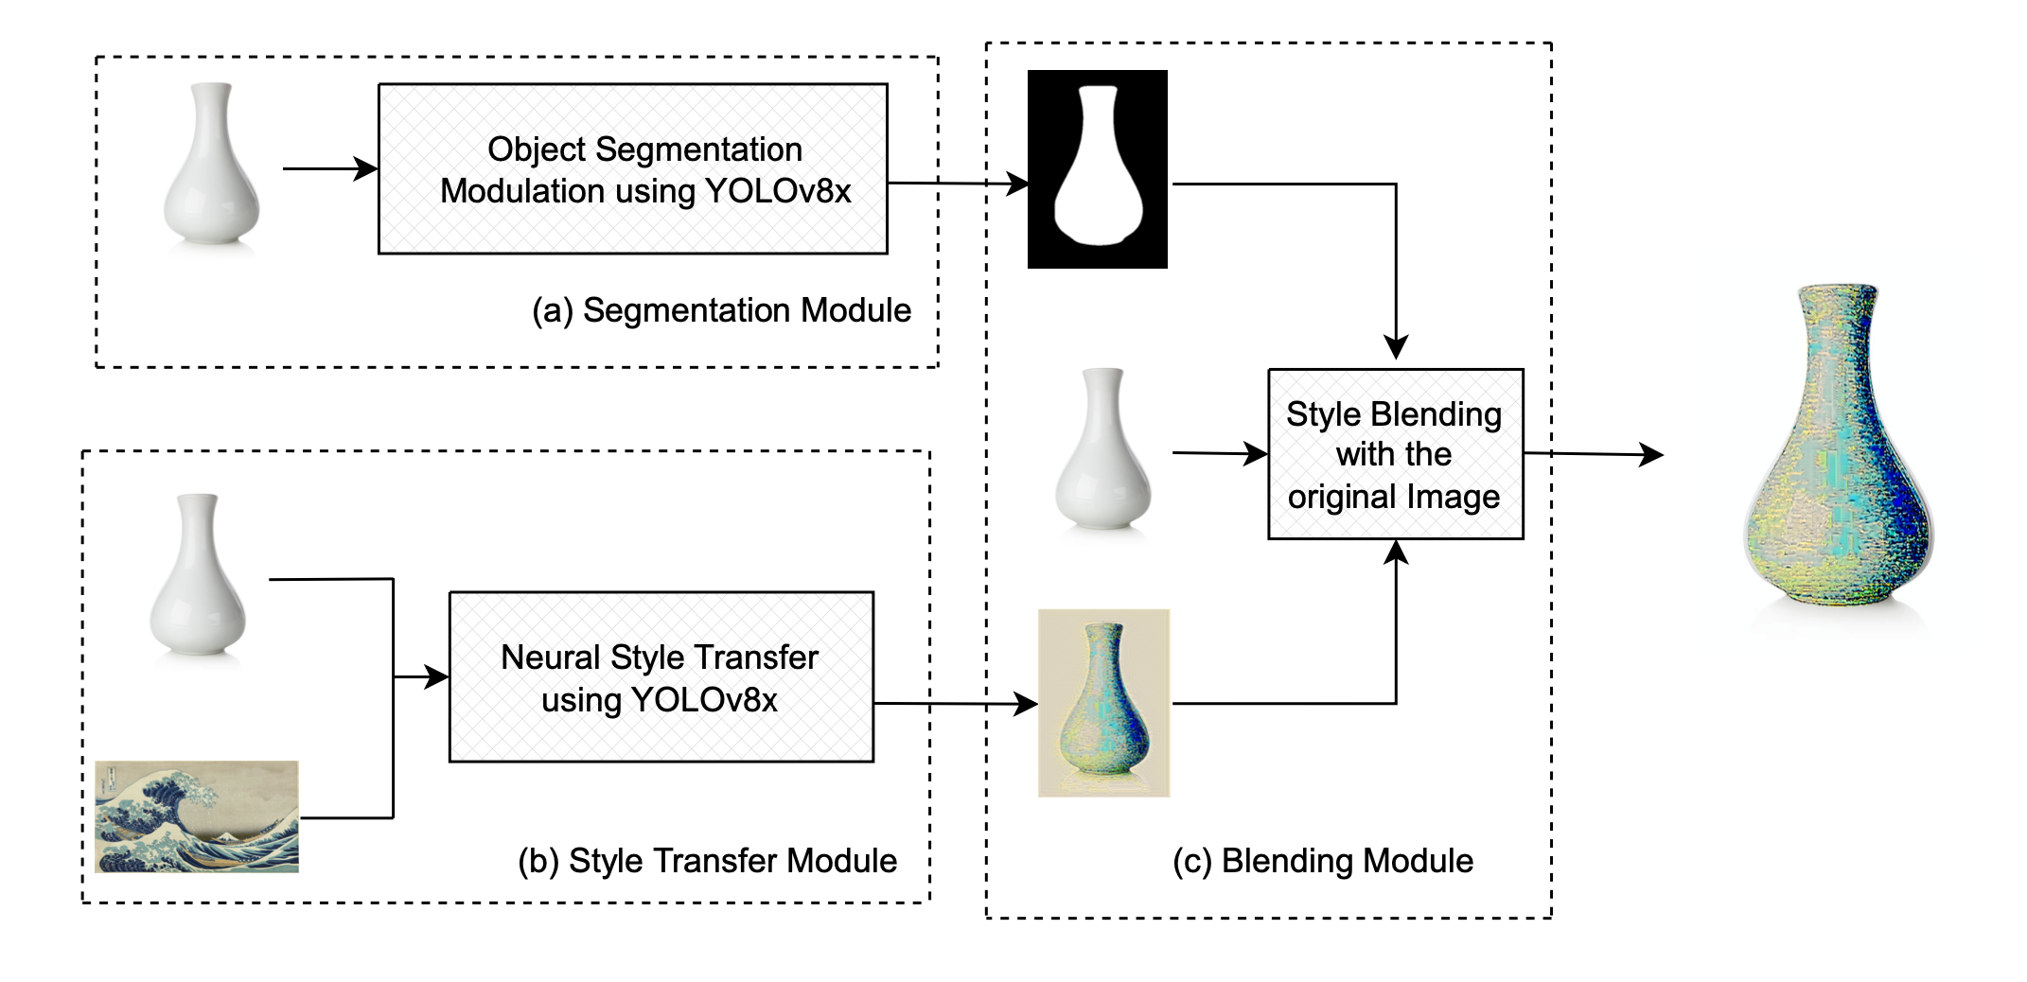
Methodology – Part 1 : Object Based Style Transfer
Segmentation Module: The module is responsible for learning and predicting semantic segmentation masks
Style Transfer Module: The overall objective of this module is to find the optimal generated image that minimizes total loss
Blending Module: The module is responsible for integrating the isolated object back into the original image by adding the styled portion back into the original image, completing the object-based neural style transfer.
Architecture Pipeline
COEP Technological University (COEP Tech) , Pune (A Unitary Public University of Govt. Of Maharashtra)

Slide 14
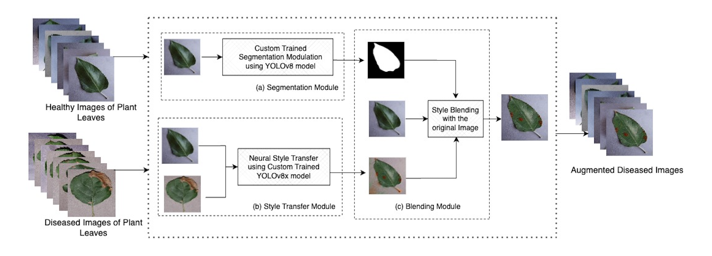
Methodology – Part 2
Segmentation Module: Custom-trained YOLOv8 segmentation model generates binary mask for each healthy leaf
Style Transfer Module: Transfer the style observed in diseased leaves onto healthy leaves
Blending Module: Previously generated mask extracts the portion of the leaf from the styled image. This extracted portion is overlaid onto the corresponding area of the original image
COEP Technological University (COEP Tech) , Pune (A Unitary Public University of Govt. Of Maharashtra)

Slide 15
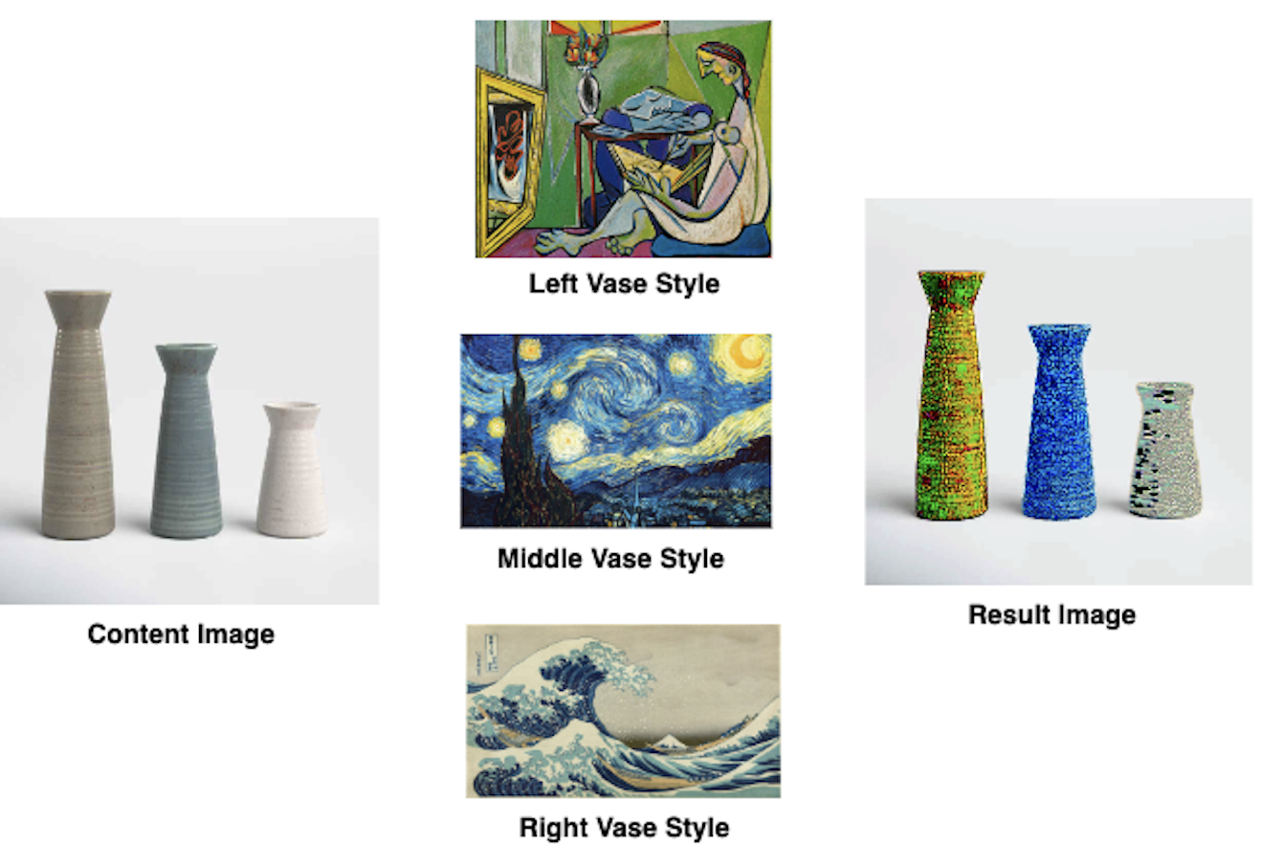
Results – Part 1
Results for object-based style transfer using YOLOv8 Image Segmentation Model on single object
Results for object-based style transfer using multiple style images on multiple objects within a single image
COEP Technological University (COEP Tech) , Pune (A Unitary Public University of Govt. Of Maharashtra)

Slide 16
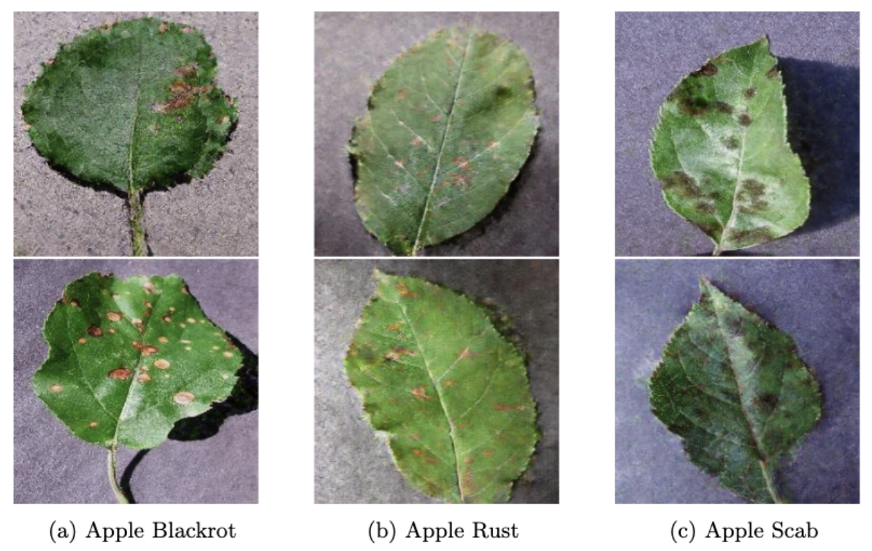
Results – Part 2
Results of Data Augmentation based on Neural Style Transfer
COEP Technological University (COEP Tech) , Pune (A Unitary Public University of Govt. Of Maharashtra)

Slide 17
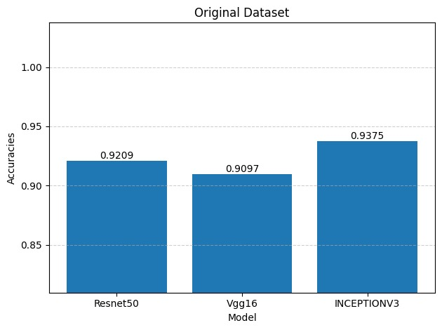
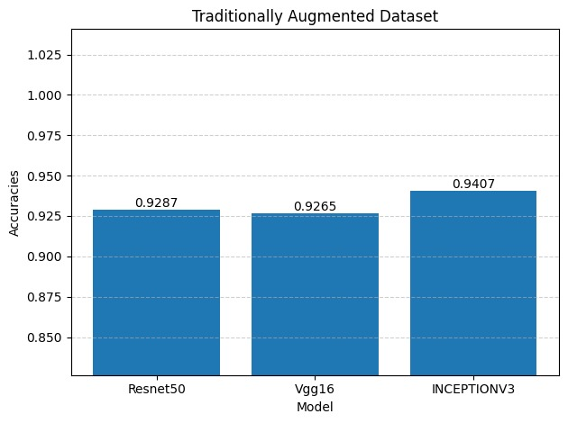
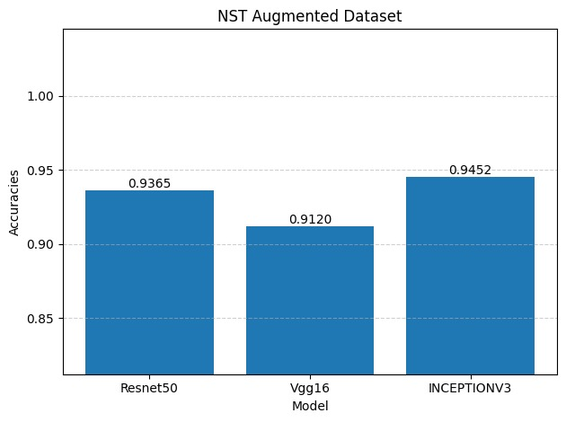
Results – Part 2
Results of ResNet50, Vgg16 and InceptionV3 trained on Original PlantVillage Dataset, Traditionally Augmented PlantVillage Dataset and NST Augmented PlantVillage Dataset.
COEP Technological University (COEP Tech) , Pune (A Unitary Public University of Govt. Of Maharashtra)

Slide 18
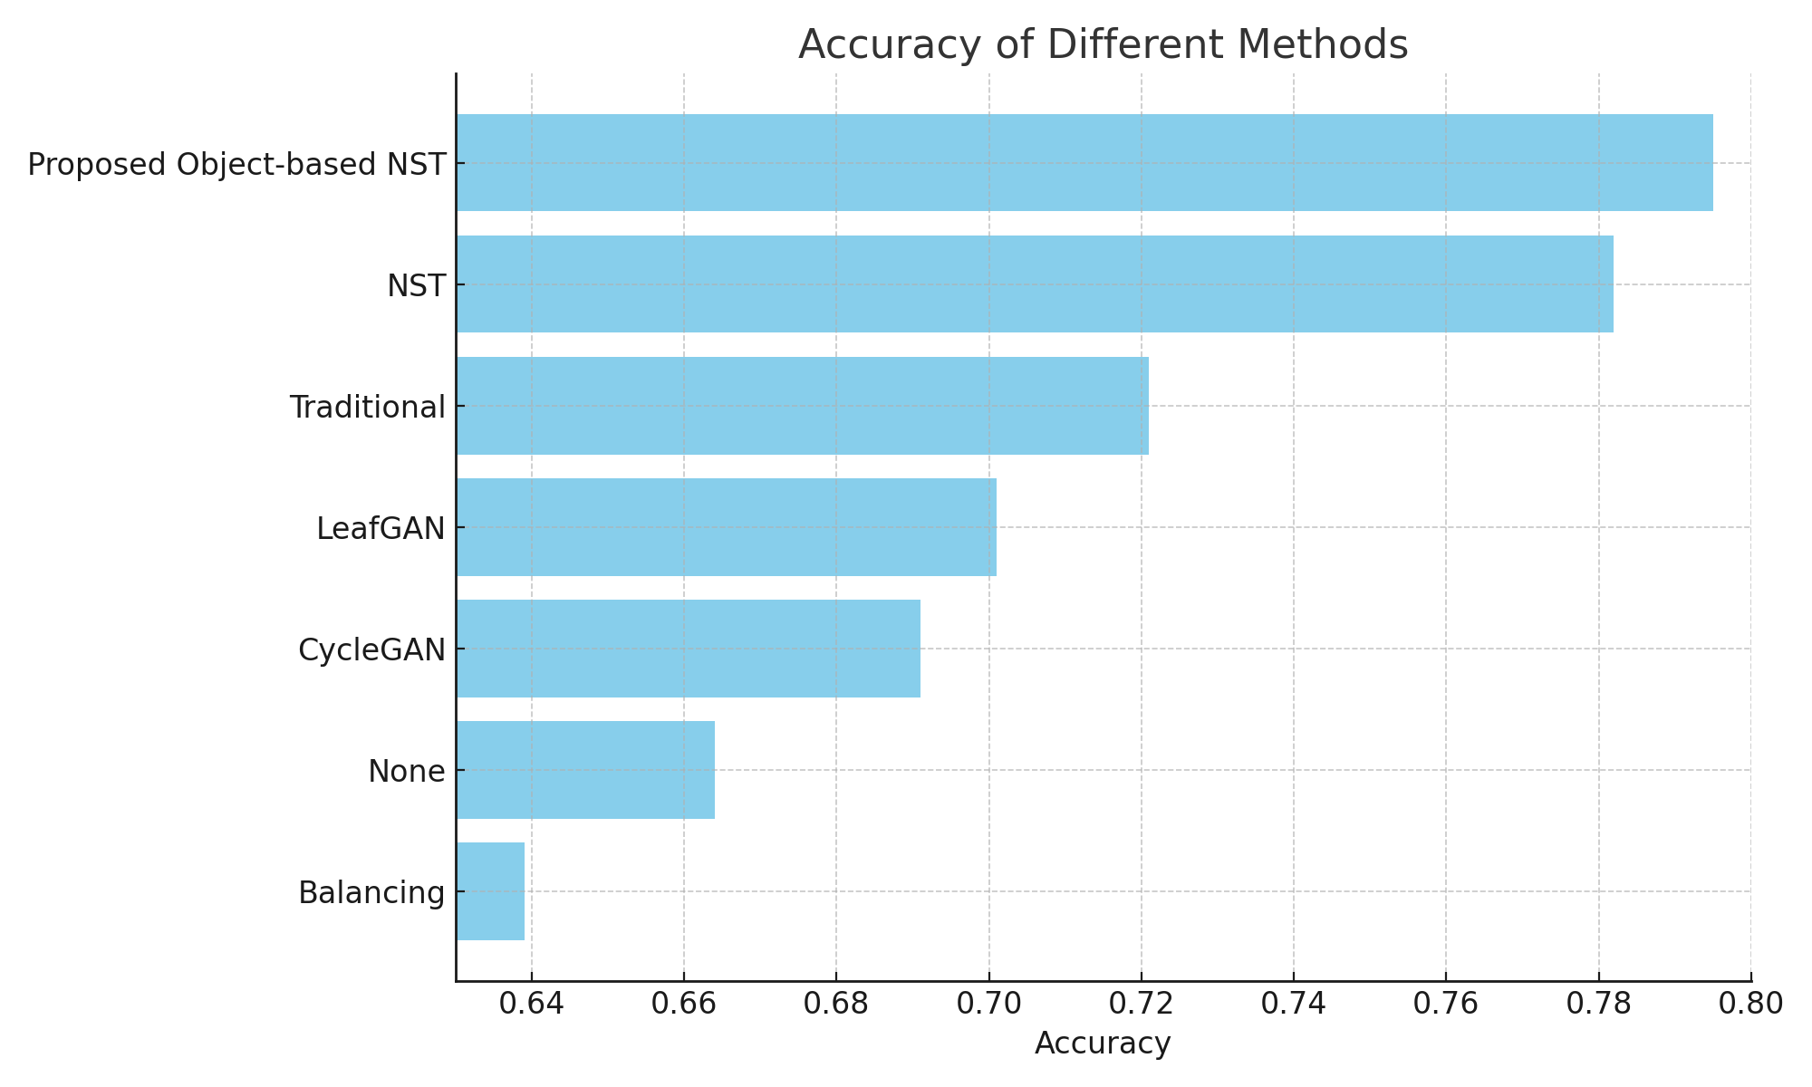
Results – Part 2
Technique | Time Required
LeafGAN (125 epochs) | 12 hours
CycleGAN (125 epochs) | 7 hours
Proposed NST | 3 hours
Accuracy of ResNet152 Classifier on augmented Plant Pathology Dataset for all the augmentation techniques
Time comparison of Proposed NST with different techniques to train and generate diseased leaf images
COEP Technological University (COEP Tech) , Pune (A Unitary Public University of Govt. Of Maharashtra)

Slide 19
Conclusion
We tackled the data imbalance issue in Plant Disease datasets using proposed unified object-based NST model.
Results mentioned are collected after augmentation of PlantVillage Dataset using the proposed method and a total of 20,723 images were generated.
Quality of the augmentation was confirmed by training it on different classifiers and testing it on PlantPathology Dataset.
Finally, the outcome of this research work are:
Enhanced Accuracy: Classifiers trained on the augmented PlantVillage Dataset demonstrated a marginal improvement in accuracy due to the proposed augmentation technique.
Efficient Augmentation: The proposed augmentation technique significantly reduced the time required for dataset augmentation.
Improved Generalization: Classifiers trained with the proposed augmented PlantVillage Dataset showed better generalization, performing well on the PlantPathology Dataset.
Future Work
Converting this work into a product such as a website or a portal where people can upload their dataset to get augmented dataset as output.
COEP Technological University (COEP Tech) , Pune (A Unitary Public University of Govt. Of Maharashtra)
19

Slide 20
Thank you!
COEP Technological University (COEP Tech) , Pune (A Unitary Public University of Govt. Of Maharashtra)
20

